Slide 1


Keep Others from Peeking at Your Mobile Device Screen!
Chun-Yu Chen, Bo-Yao Lin, Junding Wang, and Kang G. Shin
CSE/EECS, University of Michigan {chunyuc, boyaolin, jundwang, kgshin}@umich.edu

Slide 2
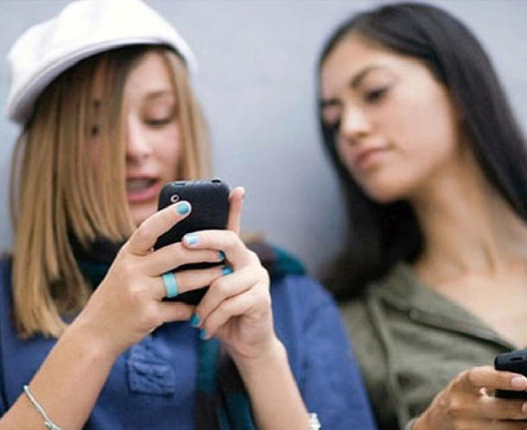
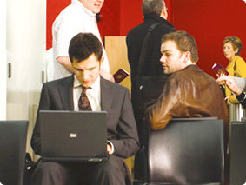
Your info can leak easily
Often you just don’t know and foresee this
https://www.datarecovery.co.nz/blog-posts/shoulder-surfing-cafe-and-office-dangers/
https://www.iznb.cn/ article/20343
Only 7% of shoulder surfing events are noticed by the user!
Eiband, M., Khamis, M., von Zezschwitz, E., Hussmann, H., & Alt, F. (2017). Understanding Shoulder Surfing in the Wild. In Proceedings of the 2017 CHI Conference on Human Factors in Computing Systems - CHI ’17 (pp. 4254–4265). New York, New York, USA: ACM Press.
Notes:
I believe everyone here has experience in using his mobile device in a public area
Sometimes you may notice that a person is peeking at others’ mobile devices or doing this action yourself.
This kind of action is called “Shoulder Surfing”.
Next
Even though people will take actions when noticing if others are looking at your screen, researches have shown that people usually do not know that actually somebody is peeking at your device.

Slide 3
Two Key Challenges to Protect On-Screen Info
Protection of on-screen information without hindering its visibility
Protection guarantee
Notes:
There are two fundamental requirements and challenges to develop a good privacy protection scheme
How to display and protect the information at the same time without blocking the information altogether?
How to provide protection guarantee?

Slide 4
Related Work and What We Want
Functionalities | Authentication Protection [1]-[6] | Delay Info Leakage [7] | Info Blocking [8][9] | Privacy Film | HideScreen
Protection Target | Authentication | Text | Text & Image | Text & Image | Text & Image
No Info Blocking | ✓ | ✓ | ✕ | ✓ | ✓
Protection Range Guarantee | ✓ | ✕ | ✓ | (✓) | ✓
No Need of Additional HW | ✓ | ✓ | ✕ | ✕ | ✓
https://cdn-reichelt.de /bilder/web/ xxl_ws/E400/ 3M_MPPAP001_01.png
Privacy film provides little to no protection when the shoulder surfer has a similar viewing angle as the user.
Notes:
There have been multiple related works proposed to solve this problem.
They focus on protecting the authentication process and general information, including texts and images.
When we look at the functionalities, authentication approaches is able to achieve the features required, but they can only be used for protecting authentication process.
On the other hand, for the approaches that aim at protecting general information can only achieve partial desired features.
***Click
The most popular method users used to protect their privacy is to apply a privacy film to their devices.
Even though they can provide good protection when the shoulder surfer has larger viewing angle as the user,
***Click
Privacy film provides little to no protection when shoulder surfer are viewing the device close to the viewing angle of the user.
***Click
In this project, we would like to propose a privacy protection scheme that is able to achieve the two functional features
***Click
And without the need of additional hardware.

Slide 5
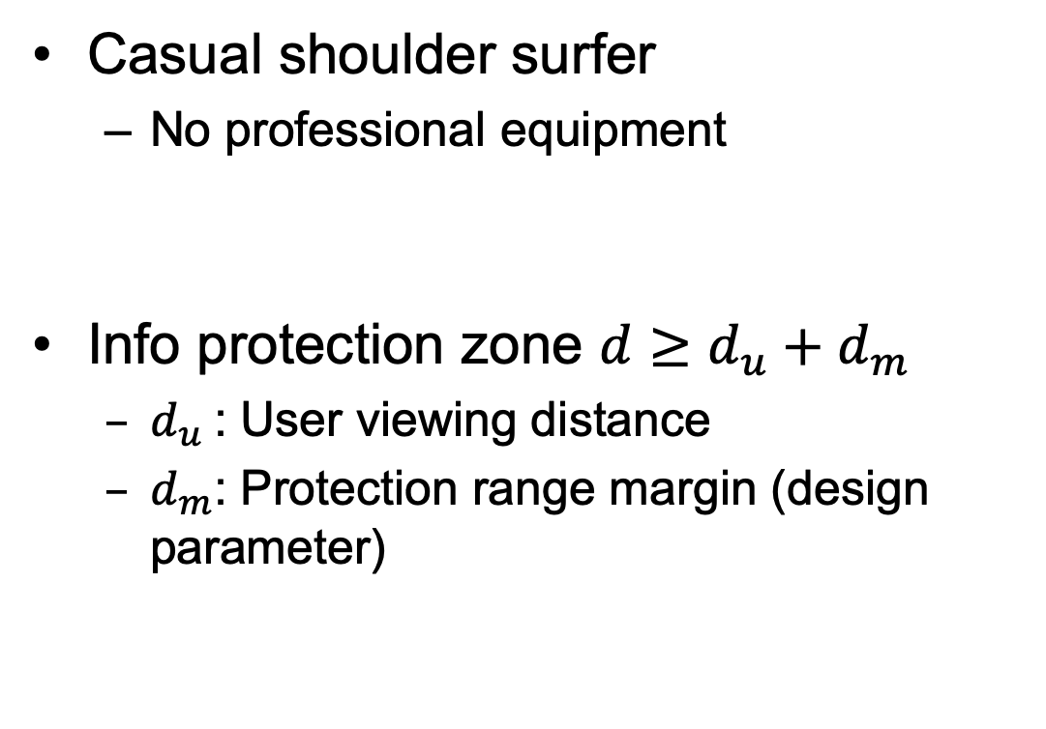
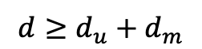
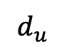
Threat Model and Info Protection Zone
Casual shoulder surfer
No professional equipment
Info protection zone $d≥d_{u}+d_{m}$
$d_{u}$: User viewing distance
$d_{m}$: Protection range margin (design parameter)
$$d_{u}$$
$$d≥d_{u}+d_{m}$$
Phone
User
Shoulder Surfer
Notes:
In this project, we consider casual shoulder surfers without professional equipment.
That is, a shoulder surfer directly peeks at user’s device or uses a smartphone camera to see the information.
The goal of our system to prevent any person to obtain the information if his/her viewing distance is larger than the viewing distance of the user by dm,
Where dm is the protection range margin which is a design parameter.

Slide 6
Two Key Challenges to Protect On-Screen Info
Protection of on-screen information without hindering its visibility
Grid-based presentation
Protection guarantee
Grid-based presentation
Notes:
Our solution to the two challenges is to utilize grid-based info presentation

Slide 7
HideScreen - Basic Idea
Use grids to show information
Bright Component
Dark Component
Grid Size
(a) View in close distance
(b) View from far away
Notes:
The fundamental concept of our system --- HideScreen --- is to utilize grids to present the information to be protected.
When the user views the grids within a designed distance, he will see the grid pattern.
However, if the shoulder surfer views the grid pattern from far away, he will only see a single color block.

Slide 8
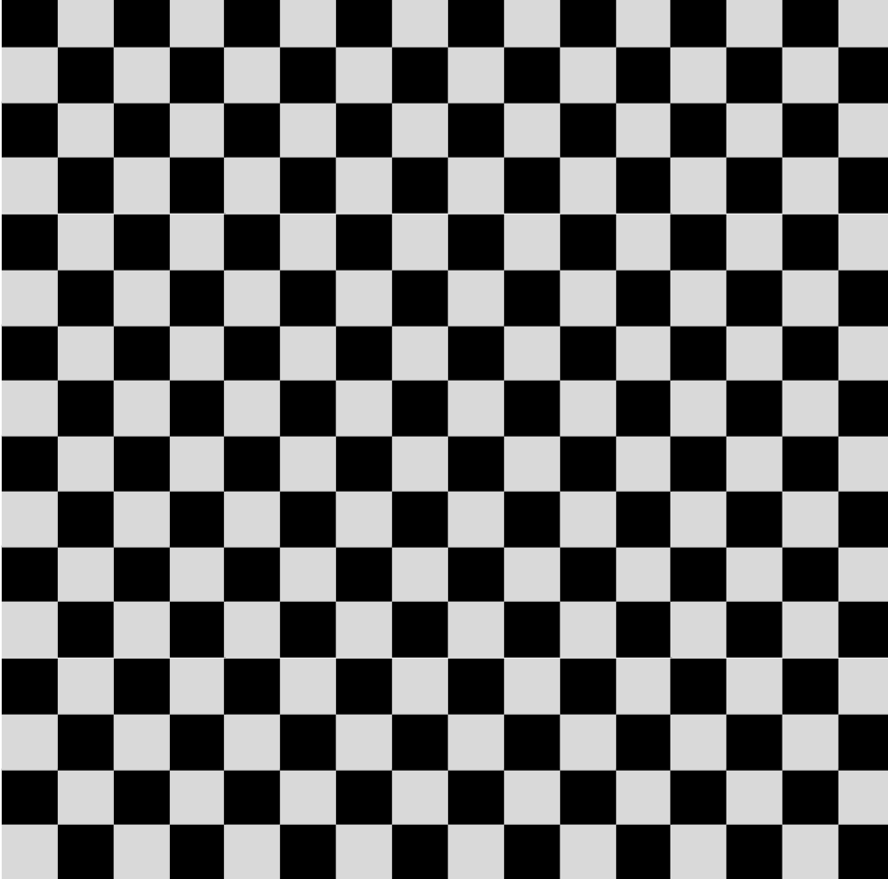
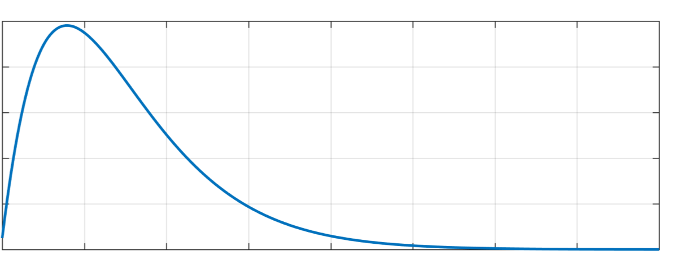
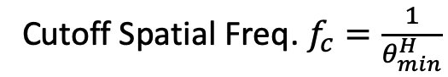
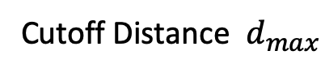
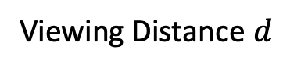
Protection Guarantee - Human Vision
0
Viewing Distance $d$
Cutoff Distance $d_{max}$
Visible Zone
Blocked Zone
Relative Sensitivity
Spatial Frequency
Cutoff Spatial Freq. $f_{c}=\frac{1}{θ_{min}^{H}}$
Notes:
This protection is based on the fact that if we increase the viewing distance of the same pattern,
it is equivalent to increase the perceived spatial frequency.
Human eyes or any other optical systems have their limitation of resolving patterns,
***Click
this limitation can be described as cutoff frequency and can be used to calculate the cutoff distance d max of the target pattern.
***Click
Therefore, given a pattern to be displayed, the maximum visible distance is also determined for each type of system used to perceive the pattern.
***Click
Within this distance d max, the optical system will be able to resolve the pattern.
***Click
Otherwise, the optical system can only perceive the mixture of the pattern.

Slide 9
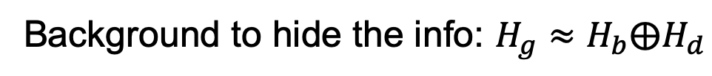
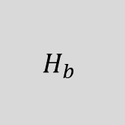
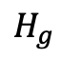


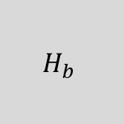
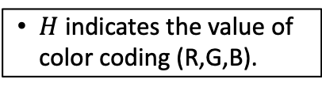
HideScreen - Basic Idea (Cont’d)
Info to be displayed
Info will blend into background when viewed outside of visible range.
$$H_{d}$$
$$H_{b}$$
$$H_{b}$$
$$H_{d}$$
$$H_{g}$$
$H$ indicates the value of color coding (R,G,B).
Background to hide the info: $H_{g}≈H_{b}⨁H_{d}$
Calibration required once per device.
Notes:
Therefore, if we display the information using grid patterns with the background color equal to the “average” color of the bright and dark components of the grid,
***Click
the information will blend into the background when viewed from far distance.
***Click
As you may notice, because every screen has different display characteristics, the screen needs to be calibrated once before applying HideScreen.

Slide 10
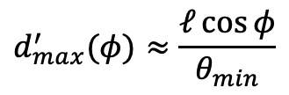

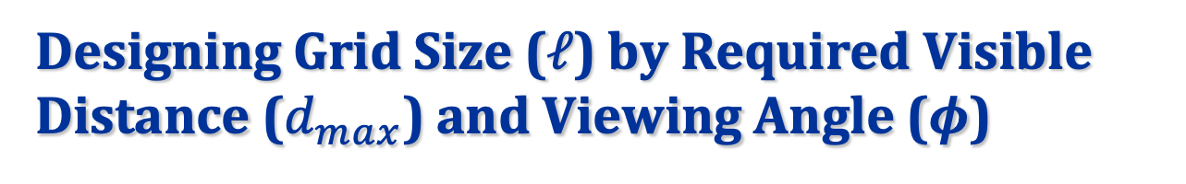
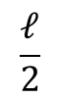
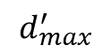
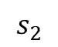
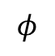
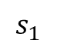
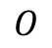
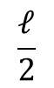
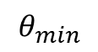

Designing Grid Size ($ℓ$) by Required Visible Distance ($d_{max}$) and Viewing Angle ($φ$)
Device Screen
(Top-Down View)
$$H_{d}$$
$$s_{1}$$
$$\frac{ℓ}{2}$$
$$φ$$
$$\frac{ℓ}{2}$$
$$H_{b}$$
$$d_{max}^{′}$$
$$s_{2}$$
$$θ_{min}$$
$$O$$
$$d_{max}^{′}(φ)≈\frac{ℓ\cos{φ}}{θ_{min}}$$
Notes:
Given the required maximum viewing distance (d max) and corresponding viewing angle (phi),
***Click
And by considering the minimum resolvable angle (theta min),
***Click
the grid size \ell can be determined.

Slide 11
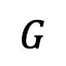
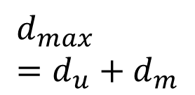
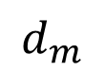

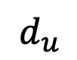
Visible Ranges
$$d_{m}$$
Visible Range of Our Scheme
$$U$$
$$d_{max} \\ =d_{u}+d_{m}$$
$$d_{u}$$
$$G$$
Equal to User’s Viewing Dist.
Threat Model
Visible Range
Notes:
To display a protected information, HideScreen will first determine the viewing distance of the user d.
***Next
Then, HideScreen will determine the required maximum visible distance (d max) equals to (d + dm).
***Next
Finally, it generates the protected information based on (d max) and limit the viewing range of the user to the blue circle area shown here.

Slide 12
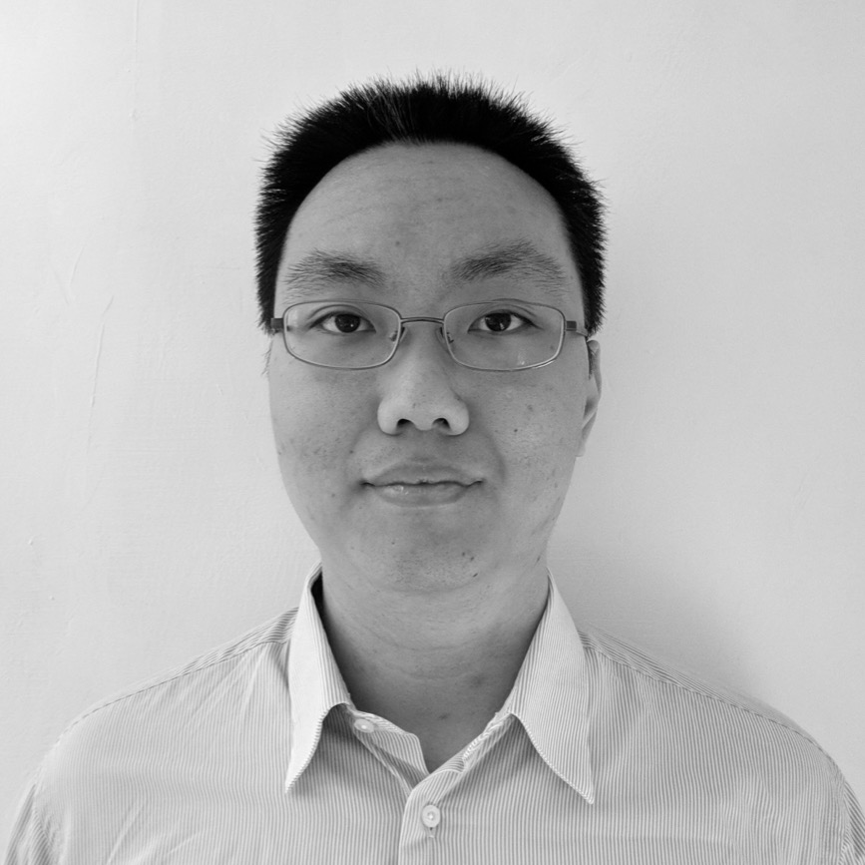
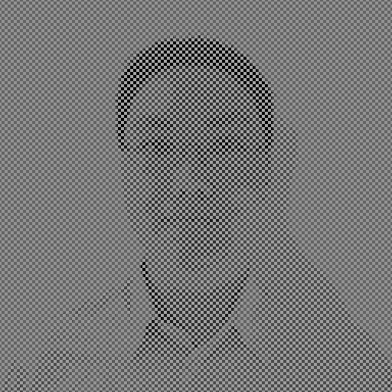
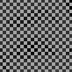
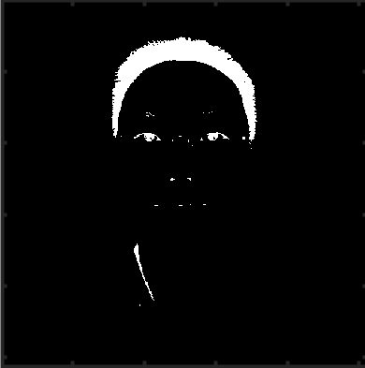
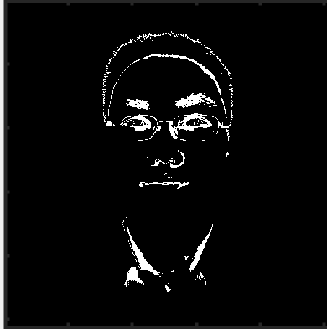
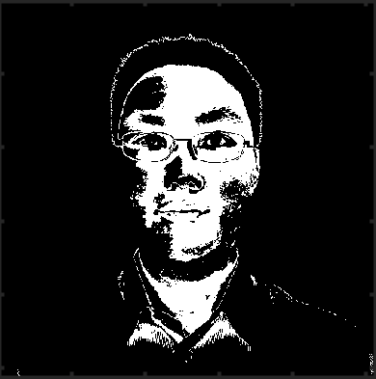
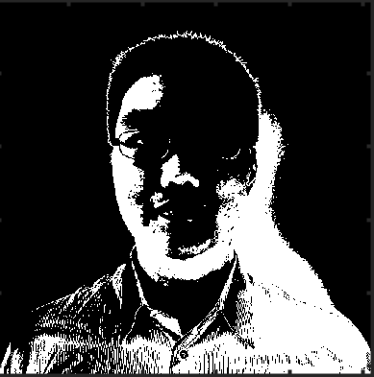
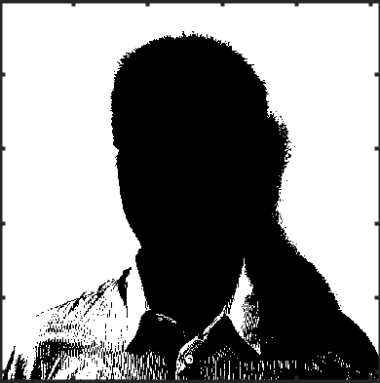
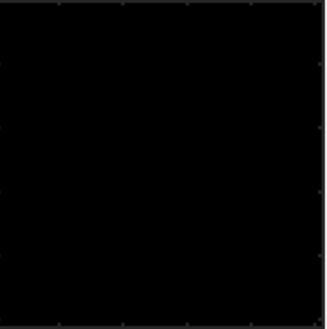
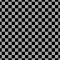
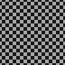
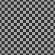



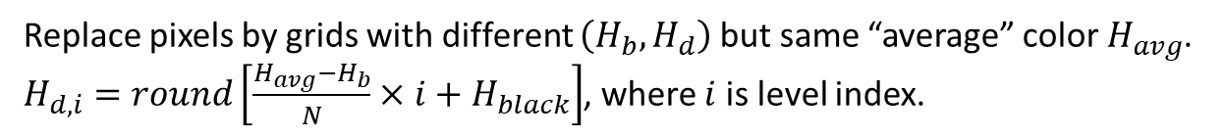
HideImage
Original
Protected
Lv.1
Lv.2
Lv.3
Lv.4
Lv.5
Lv.6
Partition pixels by grayscale value.
Replace pixels by grids with different $\left(H_{b},H_{d}\right)$ but same “average” color $H_{avg}$.
$H_{d,i}=round\left[\frac{H_{avg}−H_{b}}{N}×i+H_{black}\right]$, where $i$ is level index.
Notes:
Now we have introduced the basic idea of HideScreen, we are going to introduce how HideScreen generates protected information.
HideImage is the name of our image protection scheme in HideScreen.
Suppose we want to show this figure of me to the user.
***Next
HideImage will first divides the pixels in the figure into several levels according to their grayscale value.
***Next
Then, it will replace the pixels in each level with different grids with the same “average” color.
***Next
Finally, HideImage combines the levels together and generates the final protected image.

Slide 13
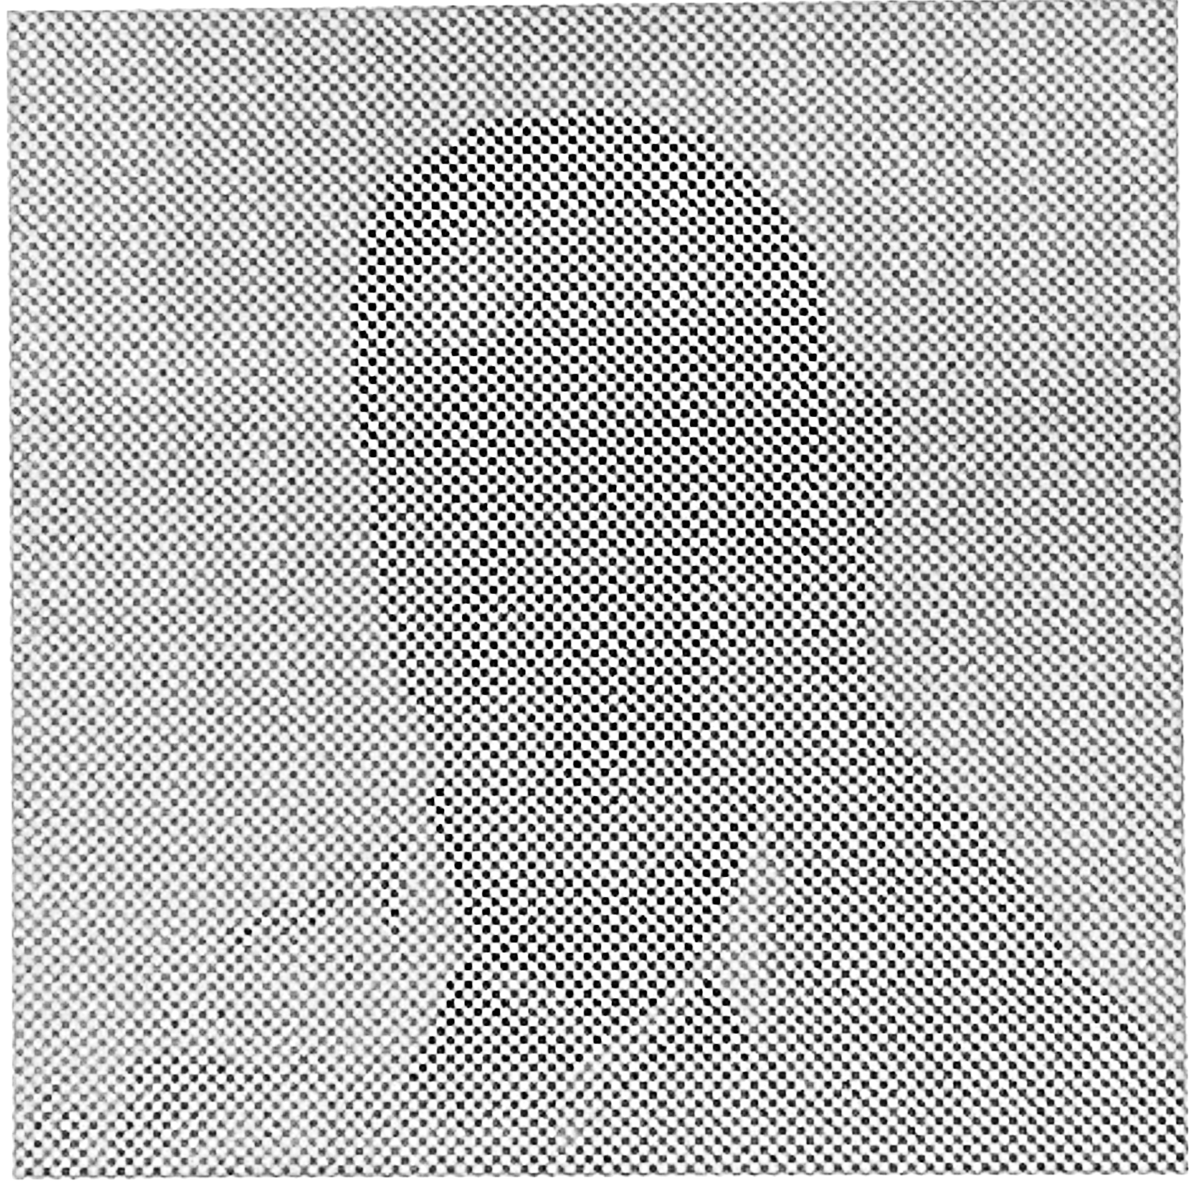
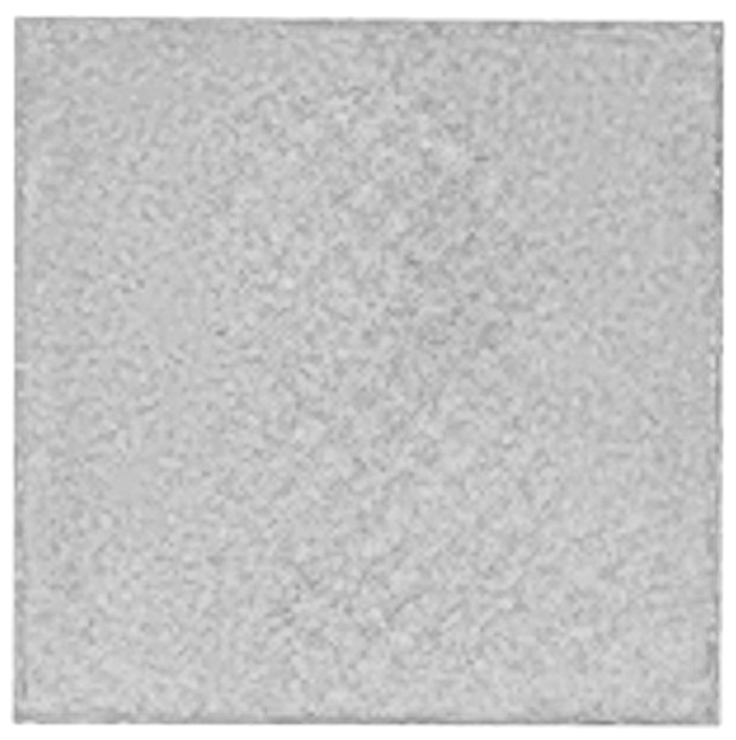
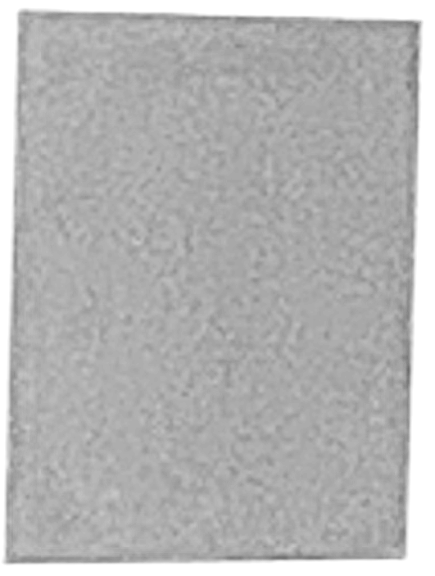
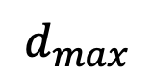

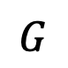
Photos of Protected Image
$$U$$
$$d_{max}$$
Visible Range of Our Scheme
$$G$$
Equal to User’s Viewing Dist.
Threat Model
Visible Range
Notes:
Here we show the photos of protected image taken by a smartphone camera,
They are taken within the designed visible range
***Click
And outside of the visible range

Slide 14
And There is One More Challenge
Protection without blockage of information
Protection guarantee
User experience
Edge enhancement
Notes:
Even though we can use the same approach we just talked about to display texts, there are some challenges related to the readability of the protected texts.
Because texts are generally smaller than images when displayed on the screens, it is sometimes hard for users to recognize the texts.
It is good in terms for protection, but not good for user experiences.

Slide 15

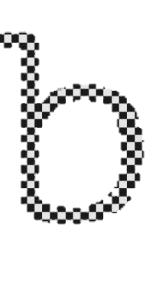
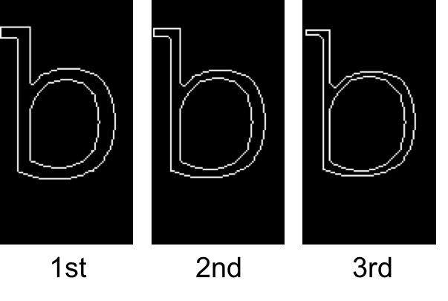
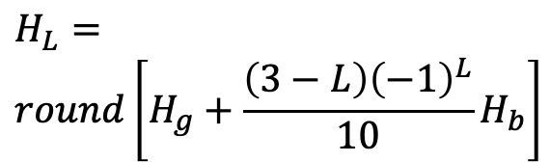
HideText
book
$$H_{L}= \\ round\left[H_{g}+\frac{\left(3−L\right){\left(−1\right)}^{L}}{10}H_{b}\right]$$
→
+
L = 1
2
3
Add protection
Enhance readability
Notes:
To address the issue we just mentioned, we develop HideText specifically for text protection.
***Next
First, we treat the texts information as a binary image and generate basic protected texts.
***Next
Then, HideText will enhance the readability of the text by injecting 3 layers of boundaries with different color levels.
By doing so, HideScreen not only injects the low frequency components that can enhance the readability of the information, but also inject high frequency components to reduce the effect of low frequency components that can be easily seen from far away.
***Next
HideText then combines the basic protection and edge enhancement to generate the final protected texts.

Slide 16

Protection Effectiveness
Metrics
Recognition Rate = $\frac{\# of Correclty Identified Cases}{Total Cases}$
URR: User Recognition Rate
SSRR: Shoulder Surfer Recognition Rate
Protection Scheme | URR(%) | SSRR(%) | SSRR w/ Bin. (%)
HideText | > 99 | < 4 | < 0.1
HideImage | > 92 | < 1 | < 0.1
Mismatch of visible distance and focus range!
Notes:
We have recruited 20 people from our campus to evaluate the protection performance of HideScreen.
The results have shown that HideScreen can provide very high protection rate with only less than 4 percent of shoulder surfer recognition rate.
At the mean time, the user can have close to 100 percent recognition rate.
The results indicate that HideScreen can achieve our design goal that users are able to read the information while the shoulder surfers can not.
Next
Furthermore, the recognition rate for the shoulder surfers with binoculars are close to 0 percent because of the mismatch between the visible distance and binoculars’ focus range.

Slide 17




Use-Case Study
Account Login
PIN Entering
Messaging
 | Account Login | PIN Entering | Messaging
Adjective UX rating | OK+ | Good+ | Good+
Will use frequently | 72% | 96% | 96%
Notes:
We also perform use-case study by implementing 3 applications with HideScreen support, including Account Login,
***Click
PIN entering
***Click
and Messaging.
The results have shown that HideScreen can provide OK to excellent adjective user experience rating and more than 70 percent of the participants indicate that they will use apps with HideScreen support frequently.

Slide 18

Conclusions
Information protection schemes are proposed
HideText
HideImage
(Sel-Image)
Text protection effectiveness
User recognition rate $>99$%
SS recognition rate $<4$%
Image protection effectiveness
User recognition rate $>93$%
SS recognition rate $<1$%
OK – Excellent adjective user experience
User sees
Shoulder surfer sees
Notes:
In conclusion, we have developed a set of information protection scheme called, HideScreen, for mobile device users in public area.
The results have shown that HideScreen is able to achieve both good protection rate and good user experience.

Slide 19
Thank you
Chun-Yu Chen, Bo-Yao Lin, Junding Wang, and Kang G. Shin
{chunyuc, boyaolin, jundwang, kgshin}@umich.edu

Slide 20
References
Gugenheimer, J., De Luca, A., Hess, H., Karg, S., Wolf, D., & Rukzio, E. (2015). ColorSnakes: Using Colored Decoys to Secure Authentication in Sensitive Contexts. In Proceedings of the 17th International Conference on Human-Computer Interaction with Mobile Devices and Services - MobileHCI ’15 (pp. 274–283). New York, New York, USA: ACM Press. https://doi.org/10.1145/2785830.2785834
Eekelen, W. ;, Van Den Elst, J. ;, Khan, J. V, Van Eekelen, W., Van Den Elst, J., & Khan, V.-J. (2014). Dynamic layering graphical elements for graphical password schemes. Proceedings of the Chi Sparks 2014 Conference, 65–73. Retrieved from https://pure.tue.nl/ws/files/59847497/Chi_Sparks_2014_proceedings.pdf
von Zezschwitz, E., De Luca, A., Brunkow, B., & Hussmann, H. (2015). SwiPIN - Fast and Secure PIN-Entry on Smartphones. In Proceedings of the 33rd Annual ACM Conference on Human Factors in Computing Systems - CHI ’15 (pp. 1403–1406). New York, New York, USA: ACM Press. https://doi.org/10.1145/2702123.2702212
De Luca, A., Hertzschuch, K., & Hussmann, H. (2010). ColorPIN. In Proceedings of the 28th international conference on Human factors in computing systems - CHI ’10 (p. 1103). New York, New York, USA: ACM Press. https://doi.org/10.1145/1753326.1753490
Winkler, C., Gugenheimer, J., De Luca, A., Haas, G., Speidel, P., Dobbelstein, D., & Rukzio, E. (2015). Glass Unlock: Enhancing Security of Smartphone Unlocking through Leveraging a Private Near-eye Display. In Proceedings of the 33rd Annual ACM Conference on Human Factors in Computing Systems - CHI ’15 (pp. 1407–1410). New York, New York, USA: ACM Press. https://doi.org/10.1145/2702123.2702316
Papadopoulos, A., Nguyen, T., Durmus, E., & Memon, N. (2017). IllusionPIN: Shoulder-Surfing Resistant Authentication Using Hybrid Images. IEEE Transactions on Information Forensics and Security, 12(12), 2875–2889. https://doi.org/10.1109/TIFS.2017.2725199
Eiband, M., von Zezschwitz, E., Buschek, D., & Hußmann, H. (2016). My Scrawl Hides It All. In Proceedings of the 2016 CHI Conference Extended Abstracts on Human Factors in Computing Systems - CHI EA ’16 (pp. 2041–2048). New York, New York, USA: ACM Press. https://doi.org/10.1145/2851581.2892511
Tarasewich, P., Conlan, R., & Gong, J. (2006). Protecting Private Data in Public. In Extended Abstracts Proceedings of the 2006 Conference on Human Factors in Computing Systems.
Lian, S., Hu, W., Song, X., & Liu, Z. (2013). Smart privacy-preserving screen based on multiple sensor fusion. IEEE Transactions on Consumer Electronics, 59(1), 136–143. https://doi.org/10.1109/TCE.2013.6490252

